Slide 1

ARULMIGU PALANIADAVAR COLLEGE OF ARTS AND CULTURE
DEPARTMENT OF MATHEMATICS
Course Name : Data Literacy With Tableau
Project Name: Unveiling Market Insights
ANALYSING SPENDING BEHAVIOUR AND IDENTIFYING OPPURUNITIES FOR GROWTH
TEAM MEMBERS
K.JERLINA NANCY
A.ISHA KARTHIKEYINI
A.KOWSALYA
S.SUDHARSAN
MENTOR
K.MARUTHUMUTHU

Slide 2
INTRODUCTION TO TABLEAU
Tableau Desktop is a data visualization application to facilitate you to examine virtually any kind of structured data and generate highly interactive, beautiful graphs, dashboards and reports within minutes.
Once a quick installation, you can tie to virtually any data source from spreadsheets to data warehouses and display information in several graphic perspectives.
Designed to be easy to utilize you will be working more rapidly than ever before.

Slide 3
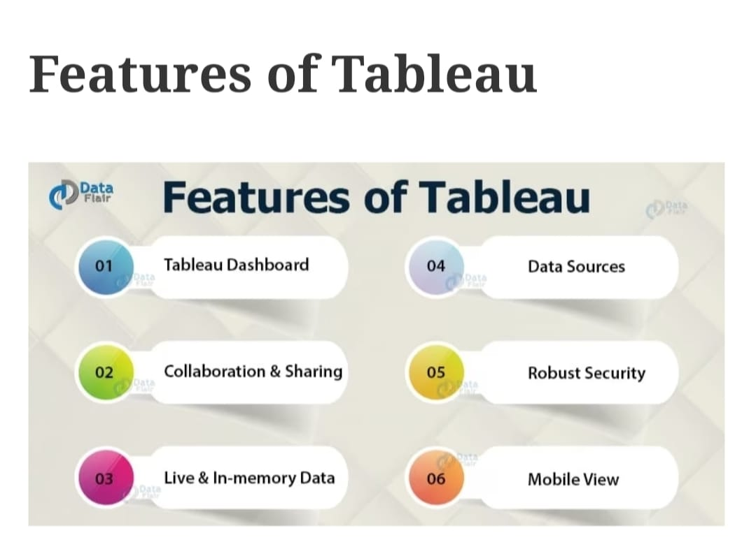
KEY FEATURES OF TABLEAU

Slide 4
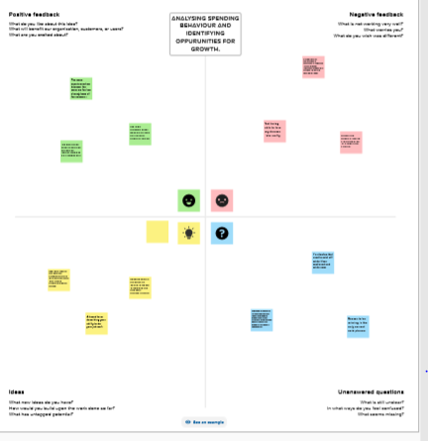
EMPATHY MAP

Slide 5
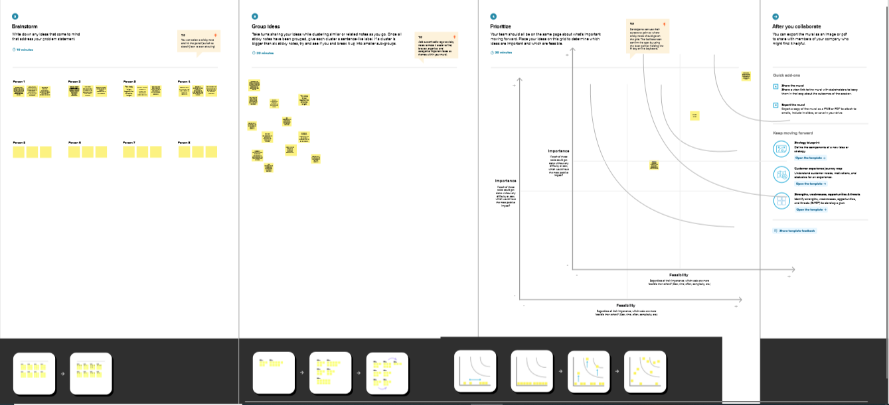
BRAINSTORMING MAP

Slide 6
DATA SET

Slide 7
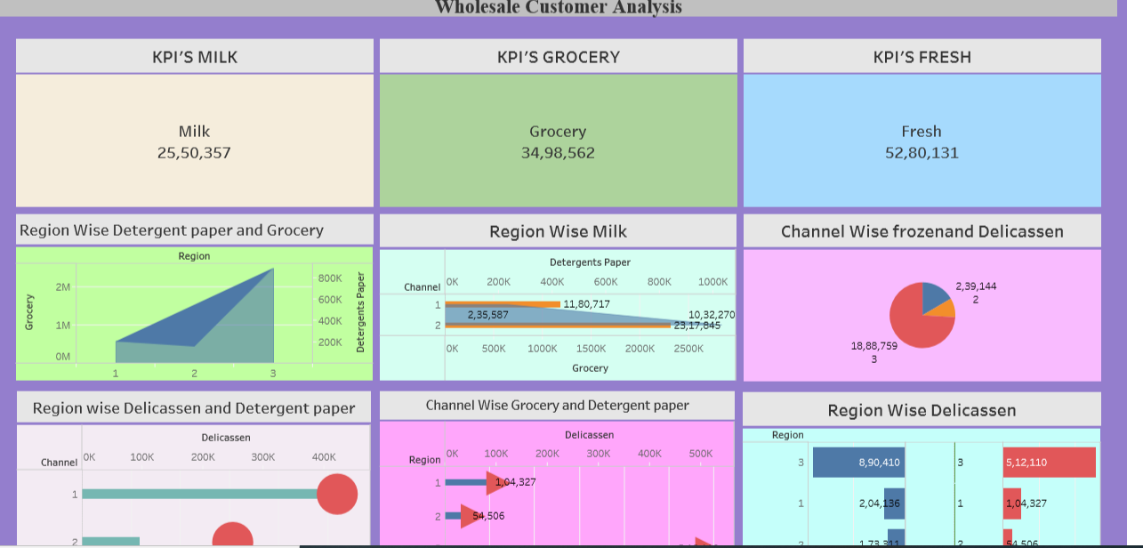
DASHBOARD

Slide 8
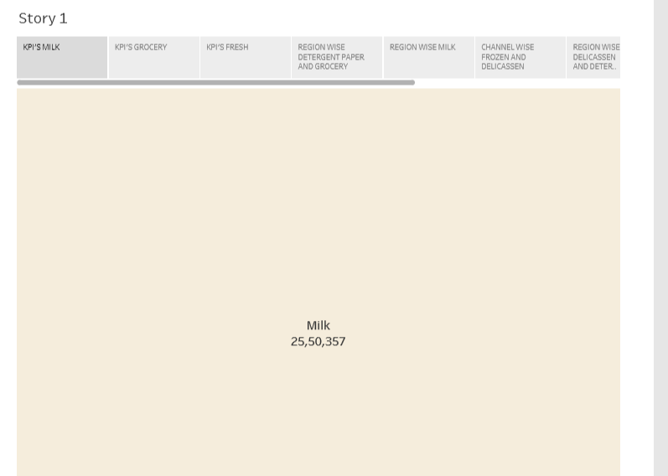
STORY

Slide 9
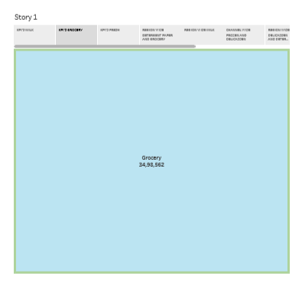

Slide 10
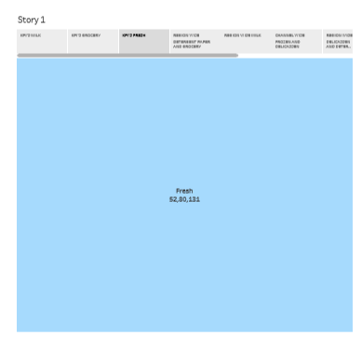

Slide 11
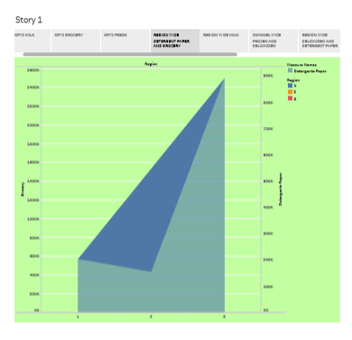

Slide 12
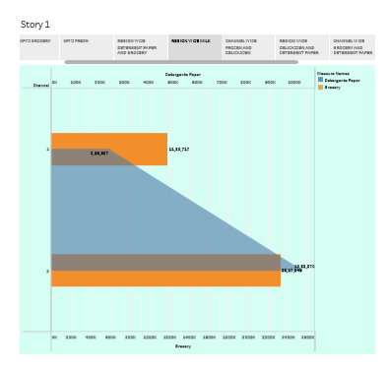

Slide 13
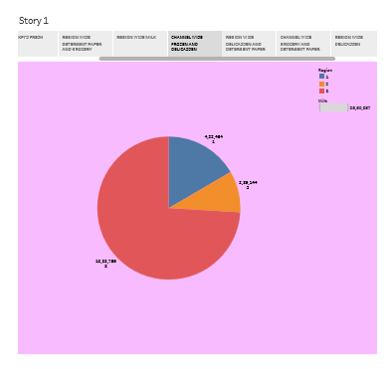

Slide 14
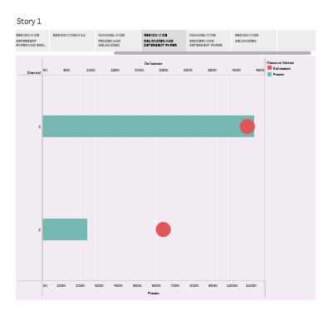

Slide 15
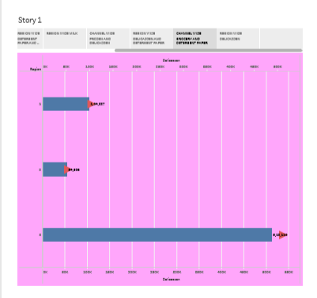

Slide 16
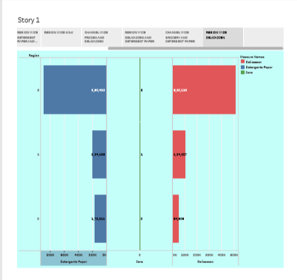

Slide 17
TABLEAU PUBLIC LINK
https://public.tableau.com/app/profile/jerlina.nancy/viz/wholesalecustomeranalysis_16965621069300/Dashboard1?publish=yes
https://public.tableau.com/app/profile/jerlina.nancy/viz/wholesalecustomeranalysis_16965621069300/Dashboard1?publish=yes

Slide 18
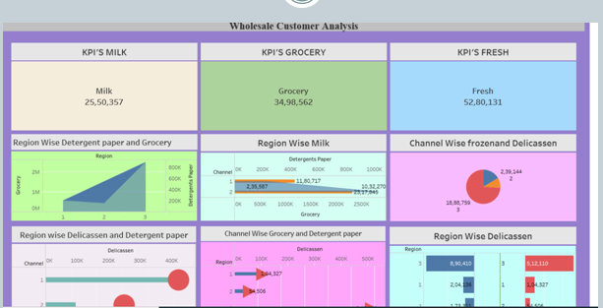
SCREENSHORT OF DASHBOARD

Slide 19
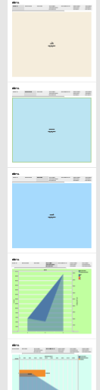
SCREENSHORT OF STORY

Slide 20
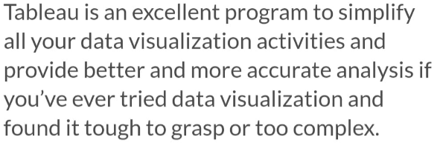
CONCLUSION

Slide 21
THANK YOU

